Slide 1
Generation IV Reactor International Efforts American Nuclear Society Washington D.C. Section
John E. Kelly
Deputy Assistant Secretary for Nuclear Reactor Technologies
Office of Nuclear Energy
U.S. Department of Energy
December 17, 2013

Slide 2
Generation IV Nuclear Reactors

Slide 3
Existing Nuclear Commercial Power Reactors
Number of reactors
10+
1-9

Slide 4
U.S. Public See Vital Role for Nuclear Energy
Nuclear Energy Institute – Commissioned Bisconti Research Inc. with Quest Global Research
National survey of public opinion conducted September 5 – 15, 2013
1000 U.S. Adults interviewed
82% believe that nuclear energy will play an important role in meeting the future electric needs
85% think that nuclear energy’s importance in meeting U.S. electricity needs will increase or remain the same
69% favor of the use of nuclear energy
29% remain opposed to nuclear energy
“Long-term trends reveal a sea change in perceptions of the safety of nuclear power plants. The percentage of Americans giving a favorable rating to the safety of nuclear power plants has doubled from 35% in 1984 to 70% this September.”
~ Ann Bisconti, Bisconti Research Inc.

Slide 5
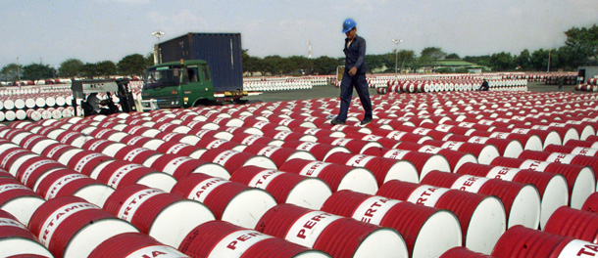
Strong International Interest in Nuclear Power
Energy Security
Nuclear shelters countries from import of costly fossil fuels
Replacing retired baseload generation plants
Climate Change Concerns
Nuclear is the “Emission-free” base load generation technology
Dry condenser cooling possible with SMRs when water usage is restricted
Environmental Protection
Replacing coal with nuclear can alleviate air pollution problems
Economic Incentives
Nations rich in fossil fuel would prefer to export those fuels and use nuclear for domestic electricity production
Notes:
Photos: Beijing pollution and image from Center fro American Progress, Securing America’s Future, http://www.americanprogress.org/issues/green/report/2009/08/25/6520/securing-americas-future

Slide 6
Global Nuclear Construction Plans
Number of reactors planned
10+
1-9
Might Build
Won’t Build
434 nuclear reactors operating in 30 countries (373 GWe capacity; 12.3% of electricity)
69 reactors currently under construction in 15 countries (28 in China)
164 reactors planned in 27 countries over next 8-10 years
317 reactors proposed in 37 countries over next 15 years
~ Source: IAEA information & news reports

Slide 7
China is Driving the Nuclear Renaissance
Most of China's electricity is produced from fossil fuels
2006 data shows 80% coal, 2% oil, 1% gas, 15% hydropower and 2% nuclear
China has 17 nuclear power reactors in operation, 30 under construction, and more about to start construction
Additional reactors are planned to increase nuclear capacity
Goal is for 58 GWe by 2020, 200 GWe by 2030, and 400 GWe by 2050
China is largely self-sufficient in reactor design and construction, and other aspects of the fuel cycle, but is making full use of western technology to adapt and improve
China will complete Gen II reactors already under construction, but any new reactors will be at least Gen III
China’s policy is for closed fuel cycle
Notes:
Info from WNA http://world-nuclear.org/info/Country-Profiles/Countries-A-F/China--Nuclear-Power/#.UjMbfKK1F8E

Slide 8
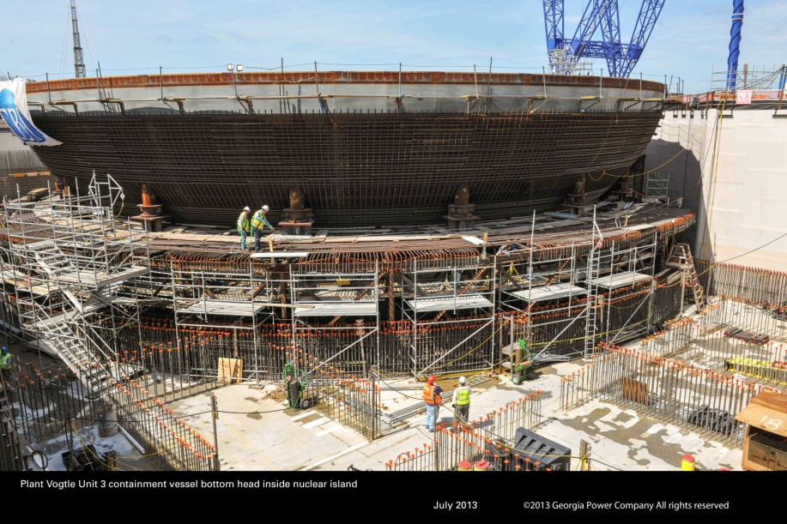
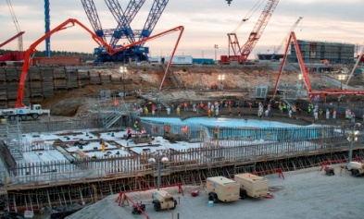
Status of New Builds in U.S.
Gen III+ designs are a major evolutionary step in large reactor technology
First new reactors being built in U.S. in 30 years
Nuclear construction
Watts Bar 2015
Vogtle 2017- 2018
V.C. Summer 2017- 2018
Turkey Point 2022 - 2023
Challenges of nuclear deployment
High capital cost
Lower electricity demand
Low natural gas prices
Post – Fukushima safety concerns
~ Plant Vogtle Unit 3 containment vessel, July 2013
Courtesy Georgia Power
~ VC Summer Unit 2 lower bowl assembly and nuclear island concrete placement, March 2013
Courtesy of SCANA
Notes:
Watts Bar 2 is a Westinghouse pressurized water reactor that is expected to generate 1,150 megawatts. Completion and fuel load planned for end of 2015
Vogtle 3&4 and V.C. Summer 2&3 are all AP1000 pressurized water reactors that will produce approximately 1150MWe each. MWe is megawatts electric
Bellefonte Unit 1 is a Babcock & Wilcox pressurized water reactor with a planned electrical output of 1,260 megawatts.
Turkey Point Units 6 & 7 are also planned to be AP1000s; the NRC lists their COL schedule as “under review” so there are no targets set for completion.
Levy County Units 1 and 2 are AP1000s; the environmental review is complete and the final Safety Evaluation Report (SER) is set for September 2013. Duke just announced plan to put Levy on hold.
William States Lee Units 1 and 2 are AP1000s; the NRC lists their COL schedule as “under review.” 1016 is COL target date for NRC.
Bellefonte - TVA cannot begin construction on Bellefonte-1 until fuel is loaded at Watts Bar-2, another partially completed unit. TVA said June 11 that it might be ready to load fuel at Watts Bar-2 in Tennessee in December 2014. The current plan is for TVA to complete Watts Bar-2 and then after fuel load is complete for that reactor (in 2015) construction will resume on Bellefonte Unit 1. Construction on Bellefonte Unit 1 actually began way back in 1974 but was cancelled in 1988. At one time, there were 3 potential Bellefonte reactors being considered. Units 3 and 4 were AP1000s, but that application was suspended.
*Dominion will amend its COL application to reflect the ESBWR technology by the end of 2013 and expects to receive the COL "no earlier than late 2015"
Pictures: Vogtle 3 courtesy of Georgia Pacific

Slide 9
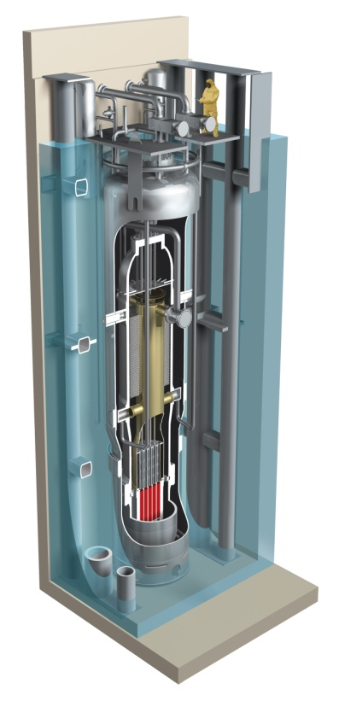
SMR Technologies are of Great Interest
Safety Benefits
Passive decay heat removal by natural circulation
Simplified design eliminates/mitigates several postulated accidents
Below grade reactor sites
Potential for reduction in Emergency Planning Zone
Economic Benefits
Reduced financial risk
Flexibility to add units
Right size for replacement of old coal and other plants
Frees up hydrocarbons for export or reduce need for fuel imports
Job and skill creation
~Courtesy of B&W mPower
~Courtesy of NuScale
mPower and NuScale have been selected for the Department of Energy SMR Licensing Technical Support Program

Slide 11
Gen IV System Development Participation

Slide 12
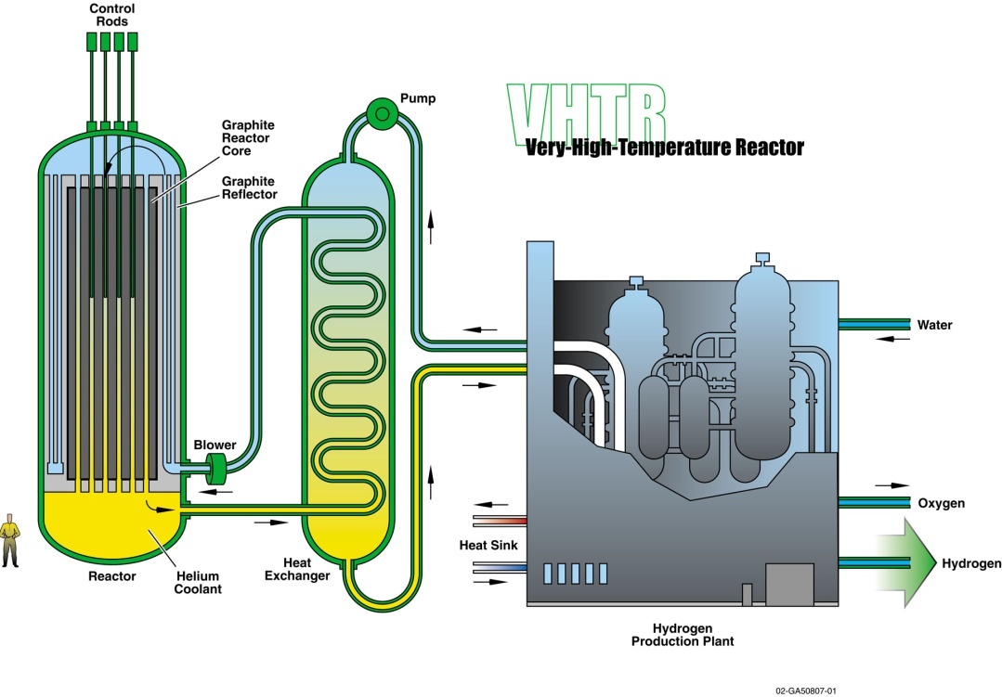
Very High Temperature Reactor
High temperature enables non-electric applications
Goal - reach outlet temperature of 1000ºC, with near term focus on 700-950°C
Reference configurations are the prismatic and the pebble bed
Designed to be “walk away safe”
R&D focus on materials and fuels
Develop a worldwide materials handbook
Benchmarking of computer models
Shared irradiations
Confirmed excellent performance of UO₂ TRISO
Japan HTTR in operation
China HTR-PM demonstration plant under construction
900° - 1000° C
Notes:
Updated Road Map may include the actual date…
GIF collaborations have resulted in improved common understanding of value of VHTR from perspective of safety and use of process heat even at temperatures below 1000 C.
Highly successful collaborations on VHTR – involving China, Japan, US, Euratom, Korea, France, Canada, and Switzerland
Irradiation testing in US, Switzerland, EU
Mechanical testing by all
Development of design codes and standards
Key points:
Strong materials collaboration and collection of worldwide data via GIF handbook

Slide 13
Fuel Particle → Pebble or Prismatic Blocks
TRISO Particles
→Compacts
→Graphite block
TRISO Particles
→Pebbles
Block

Slide 14
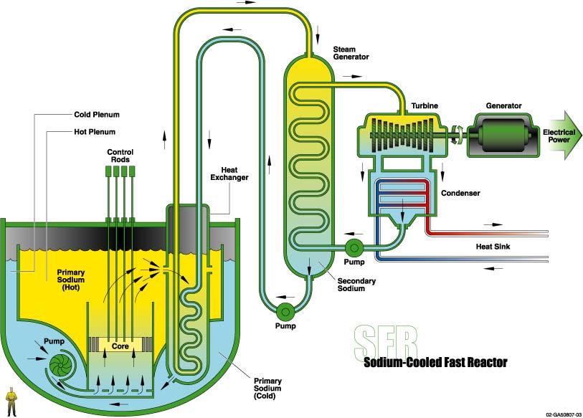
Sodium Fast Reactor
Integral part of the closed fuel cycle
Can either burn actinides or breed fissile material
Designs being developed
ASTRID (France)
JSFR (Japan)
PGSFR (Korea)
BN-1200 (Russia)
2015 planned start-up of BN-800 (Russia)
R&D focus
Analyses and experiments that demonstrate safety approaches
High burn-up minor actinide bearing fuels
Develop advanced components and energy conversion systems
550° C
Notes:
BN-1200 is under development (Russia)
PG-SFR Korean pool-type reactor with a steam Rankine cycle
Partners Joining Date
MOST (China) March 2006
JRC (Euratom) November 2006
CEA (France) February 2006
JAEA (Japan) February 2006
MEST (Korea) April 2006
ROSATOM (Russian Federation) July 2010
DOE (USA) February 2006

Slide 15
Sodium Fast Reactor R&D Focus Areas

Slide 16
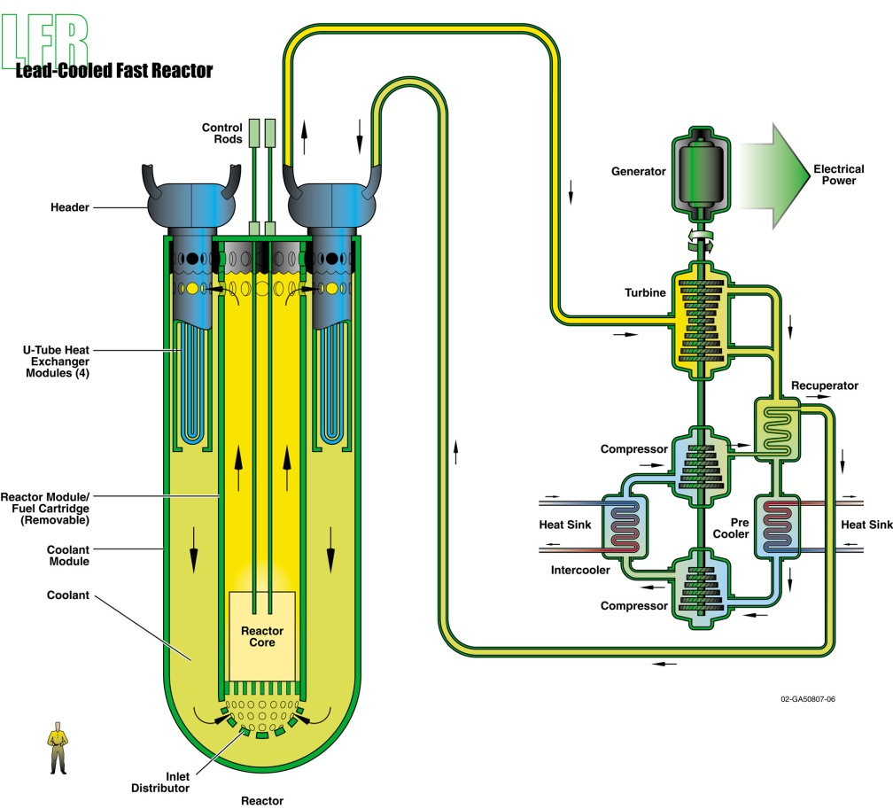
Lead Fast Reactor
Lead is not chemically reactive with air or water and has lower coolant void reactivity
Three design thrusts:
European Lead Cooled Fast Reactor (Large, central station)
Russian BREST-OD-300 (Medium size)
SSTAR (Small Transportable Reactor)
R&D focus on materials corrosion and safety
480° - 800° C
Notes:
Technologies been used in some Russian submarines.
Lead- and Lead-bismuth cooled experimental reactors planned for 2020 – 2030: ALFRED in Europe, BREST-300 in Russia, and Pb-Bi-cooled SVBR in Russia
The Lead-cooled Fast Reactor (LFR) features a fast neutron spectrum, high temperature operation, and cooling by molten lead or lead-bismuth eutectic (LBE), low-pressure, chemically inert liquids with very good thermodynamic properties. It would have multiple applications including production of electricity, hydrogen and process heat. System concepts represented in plans of the Generation-IV International Forum (GIF) System Research Plan (SRP) are based on Europe’s ELFR lead-cooled system, Russia’s BREST-OD-300 and the SSTAR system concept designed in the US.
The LFR has excellent materials management capabilities since it operates in the fast-neutron spectrum and uses a closed fuel cycle for efficient conversion of fertile uranium. It can also be used as a burner to consume actinides from spent LWR fuel and as a burner/breeder with thorium matrices. An important feature of the LFR is the enhanced safety that results from the choice of molten lead as a chemically inert and low-pressure coolant. In terms of sustainability, lead is abundant and hence available, even in case of deployment of a large number of reactors. More importantly, as with other fast systems, fuel sustainability is greatly enhanced by the conversion capabilities of the LFR fuel cycle. Because they incorporate a liquid coolant with a very high margin to boiling and benign interaction with air or water, LFR concepts offer substantial potential in terms of safety, design simplification, proliferation resistance and the resulting economic performance. An important factor is the potential for benign end state to severe accidents.
The LFR has development needs in the areas of fuels, materials performance, and corrosion control. During the next 5 years progress is expected on materials, system design, and operating parameters. Significant test and demonstration activities are underway and planned during this time frame.

Slide 17
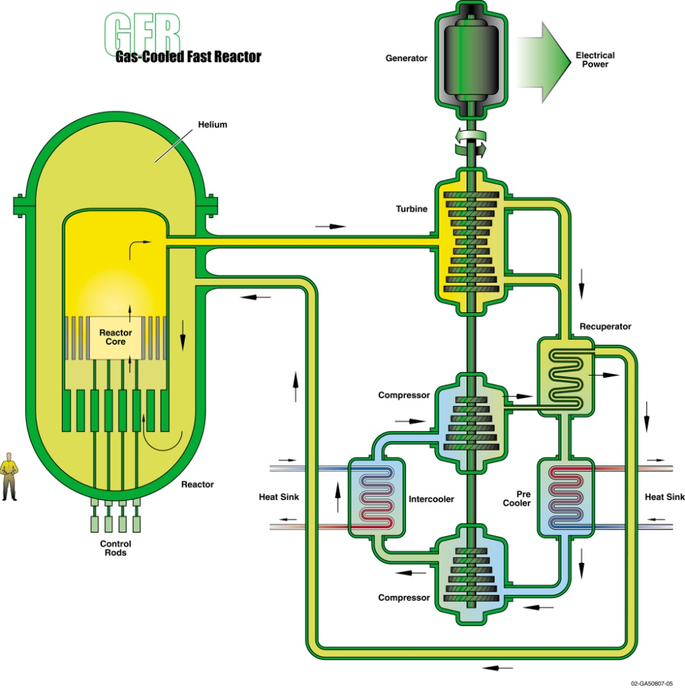
Gas-Cooled Fast Reactor
High temperature, inert coolant and fast neutrons for a closed fuel cycle
Fast spectrum enables extension of uranium resources and waste minimization
High temperature enables non-electric applications
Non-reactive coolant eliminates material corrosion
Very advanced system
Requires advanced materials and fuel
Key technical focus:
SiC clad carbide fuel
High temperature components and materials
850° C
Notes:
Quite a bit of accomplishment under GIF
Future GFR collaborations to focus on design of ALLEGRO, fuel development and qualification, and robust severe accident strategy formulation.

Slide 18
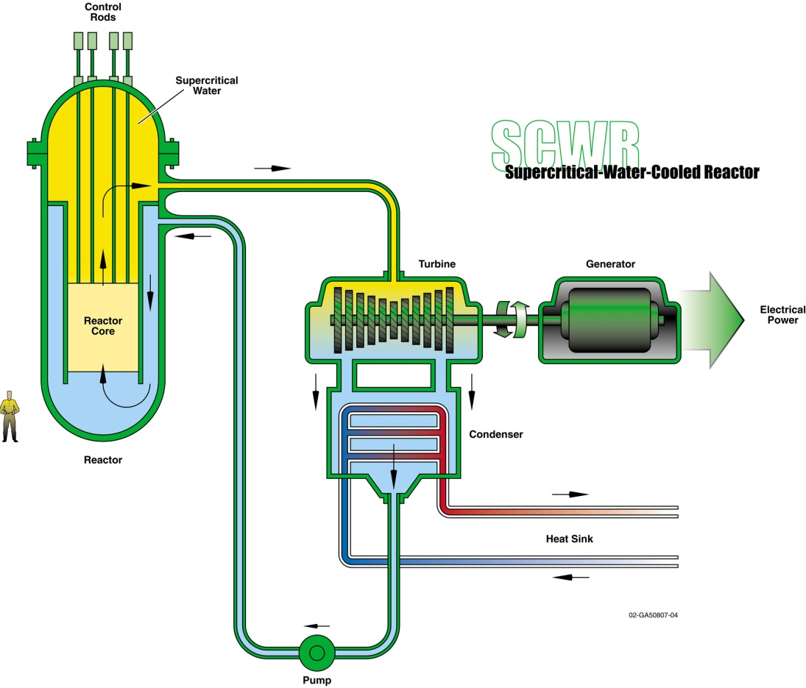
Supercritical Water-Cooled Reactor
Merges GEN-III+ reactor technology with advanced supercritical water technology used in coal plants
Operates above the thermodynamic critical point (374°C, 22.1 MPa) of water
Fast and thermal spectrum options
Key technology focus:
Materials, water chemistry, and radiolysis
Thermal hydraulics and safety to address gaps in SCWR heat transfer and critical flow databases
Fuel qualification
510° - 625° C
Notes:
Technology development is ongoing with a focus on the GIF objectives of improved safety, proliferation resistance, and economics and sustainability.
(new project is being negotiated between Canada and Europe for in-pile test of small scale fuel assembly characterizing core design features of SCWR)
So far, the SCWR R&D program has followed the GIF Systems Research Plan defined in 2009. Today, we have several design concepts that could serve as a basis for a prototype design, and a few more might follow. The thermal-hydraulics of the SCWR are also well understood in principle, and potential material candidates have been identified. Next step toward a prototype would involve small scale component tests to validate T-H models, and also larger integral tests to validate innovative safety systems. A future milestone envisioned in the next 10 years would be in pile tests of a fuel assembly under supercritical water conditions.

Slide 19
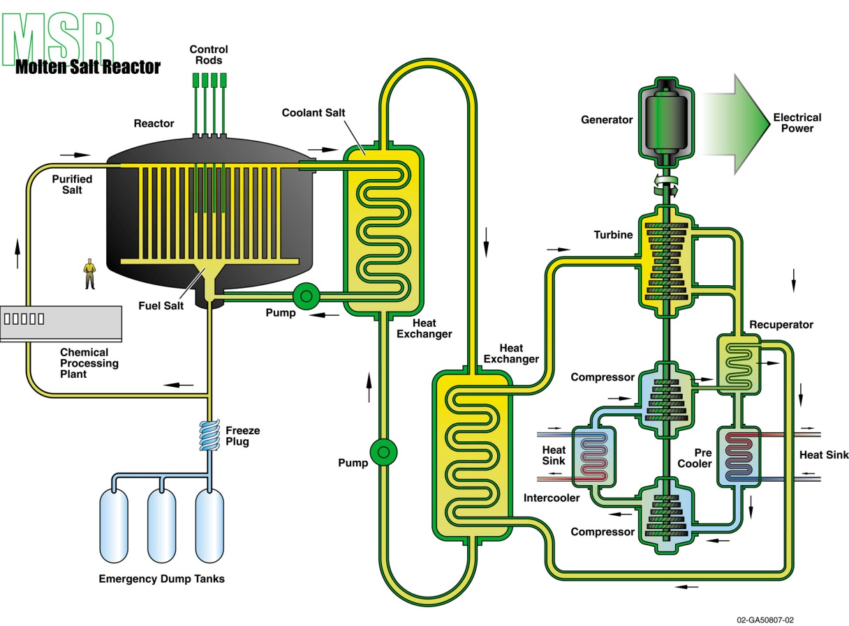
Molten Salt Reactor
High temperature system
High temperature enables non-electric applications
On-line waste management
Design Options
Solid fuel with molten salt coolant
Fuel dissolved in molten salt coolant
Key technical focus
Neutronics
Materials and components
Safety and safety systems
Liquid salt chemistry and properties
Salt processing
700° - 800° C
Notes:
The MSR is distinguished by its core in which the fuel is dissolved in molten fluoride salt.
The technology was first studied more than 50 years ago. Modern interest is on fast reactor concepts as a long term alternative to solid-fuelled fast neutrons reactors. The onsite fuel reprocessing unit using pyrochemistry allows breeding plutonium or uranium-233 from thorium. R&D progresses toward resolving feasibility issues and assessing safety and performance of the design concepts.
Key feasibility issues focus on a dedicated safety approach and the development of salt redox potential measurement and control tools in order to limit corrosion rate of structural materials. Further work on the batch-wise online salt processing is required. Much work is needed on molten salt technology and related equipment.
The members of this provisional SSC are France and Europe. US and Russia are observers. The common objectives of the SSC is to develop the conceptual design for the MSFR, resulting from the physical, chemical, and material studies – for the reactor core, the reprocessing unit and waste conditioning. Russia, an observer, works on the Molten Salt Actinide Recycler and Transmuter system. The US, which also supports as an observer is focused on fluoride salt cooled high temperature reactor as a nearer term class of reactor whose technology developments support MSRs.

Slide 20
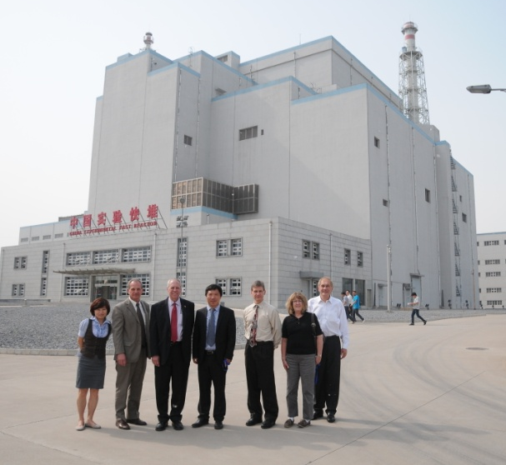
Gen IV Nuclear Construction in China
Operation of CEFR 20 MWe Test Reactor
Startup in 2010 – 2011, power operations planned to start in late December 2013 to early January 2014
Design of Demonstration Reactor
Construction of demonstration HTGR
200 MW Pebble Bed design
Scheduled to start electricity generation by the end of 2017
Design of a small Fluoride Salt Cooled Reactor
CEFR construction
CEFR Finished
First Concrete poured for China’s HTR-PM

Slide 21
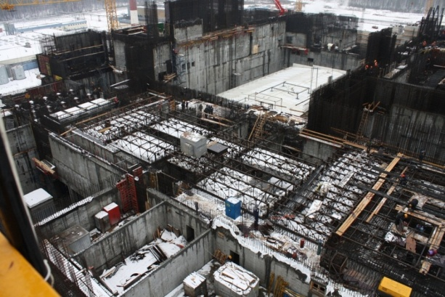
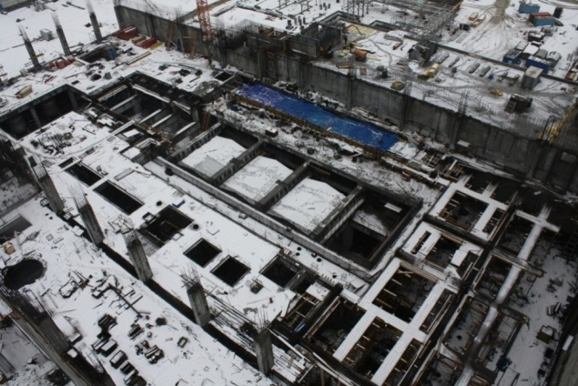
Gen IV Nuclear Construction in Russia
Completion of BN-800 Reactor
Startup in 2015
Design of BN-1200 Gen-IV SFR
Competitive economics to LWRs
Design of MBIR test reactor to replace BOR-60
Demonstration project on lead-bismuth LFR
Reactor Compartment of Main Building
Steam Generator Compartment of Main Building
Turbine Hall
Notes:
In Russia, ten reactors are under active construction, one being a large fast neutron reactor. About 14 further reactors are then planned, some to replace existing plants, and by 2017 ten new reactors totaling at least 9.2 GWe should be operating. Further reactors are planned to add new capacity. This will increase the country's present nuclear power capacity by 50% in 2020. In addition about 5 GW of nuclear thermal capacity is planned. A small floating power plant is expected to be completed by 2014 and others are planned to follow.

Slide 22
Summary
Strong international interest in Nuclear Power
Energy Security
Climate & Environment
Economic
Current construction of Gen III reactors
China is leading the nuclear renaissance
USA is making good progress
Generation IV still sets captivating goals for R&D
Gen III successes will pave the way for Gen IV

